Slide 1

LeSchedulers: Best-in-Class NBA Schedule Analysis
December 9, 2021

Slide 2

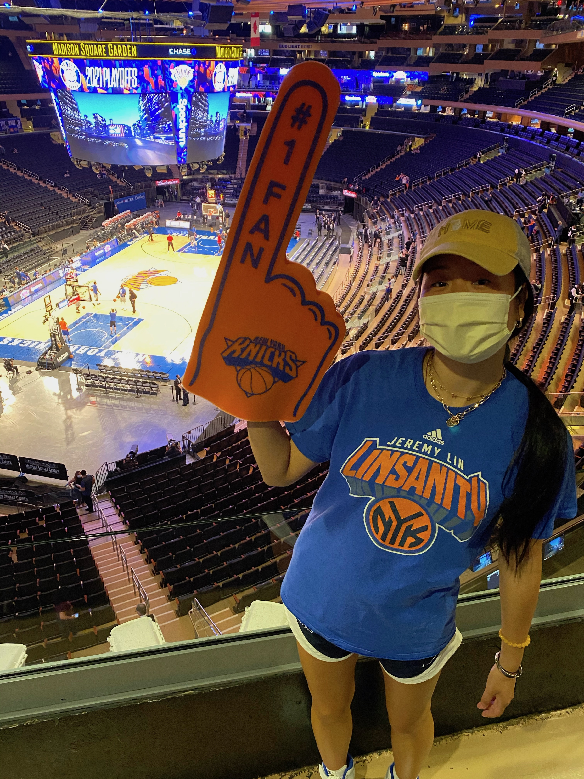




Meet the LeSchedulers
Our Team
Caitlyn Chow
Junior @ Wharton
Die-hard Knicks fan
Donovan Moore
Ticket Pricing & Inventory Analyst @ Spurs
Martha Yin
Senior @ Princeton
Pton MBB Team Manager
Rohit Tanikella
Junior @ Berkeley
Warriors Fan
Taurus Allen
Data Analyst
Also die-hard Knicks fan

Slide 3
Roadmap
Introduction of Project
Overview of Data and First Steps
Analysis 1: Timing of Games
Analysis 2: Jersey Rankings
Analysis 3: Competitiveness
Analysis 4: Road Back to Backs
Final Recommendations + Conclusion
Notes:
Allow participants that did not get to introduce themselves at Tip-Off to introduce themselves
-Welcome remarks from Evan and Q&A

Slide 4
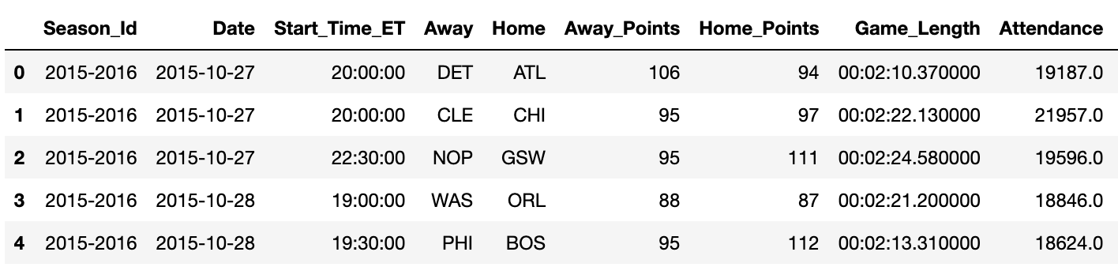
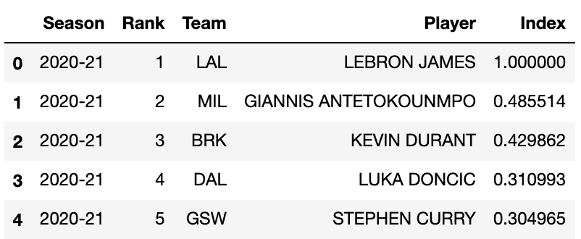
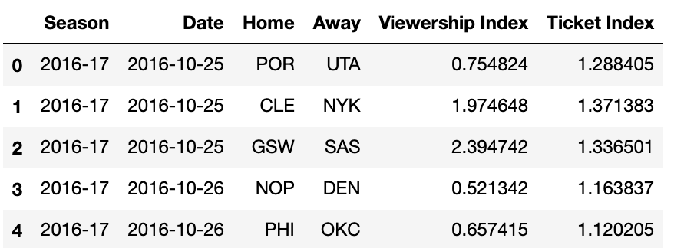
Explaining the Data
3 data sources provided: games data, ticket + viewership indices, and jersey rankings
Games Data
Historical Jersey Ranking Data
Viewership and Ticket Data

Slide 5
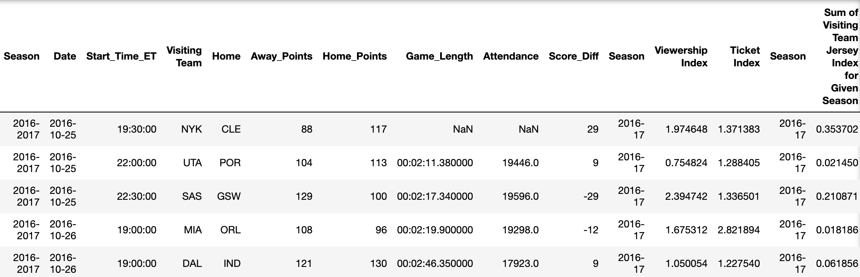
Data Wrangling
Cleaning and merging data for optimal EDA and analysis
Merged all 3 datasets for easy side-by-side analysis
Created "Score_Diff" column that represents (Home Team's Score) - (Away Team's Score) to measure competitiveness of the game (further analysis to be done in later slides)
Calculated and appended the total Jersey index for the visiting team of each game. We used this metric to measure if the visiting team made up an "A+ game" (further analysis to be done in later slides)

Slide 6
Schedule Conflicts
MLS, MLB, NFL, NHL, CFB
MLS: Regular Season Length (Mar-Oct), Playoff Season Length (Oct-Dec)
MLB: Regular Season Length (Late Mar-Oct), Playoff Season Length (Oct-Nov)
NFL: Regular Season Length (Aug-Dec), Playoff Season Length (Jan-Feb)
CFB: Regular Season Length (Aug-Dec), Playoff Season Length (Dec-Jan)
NHL: Regular Season Length (Oct-Apr), Playoff Season Length (May-July)
NBA: Regular Season Length (Oct-Apr), Playoff Season Length (Apr-June)
*Main overlap: NFL, MLB, MLS, CFB = Oct-Dec*
Notes:
MLS Playoff Games mainly happen on Sundays with a couple on Thursdays
MLB has playoff games mainly throughout days of the week in October, sometimes will spill over into November depending on length of series and scheduling but bulk is in October.

Slide 7
Attendance and Viewership
Avg Attendance and Viewership During Overlap (Oct-Dec vs. Jan-Apr)
NBA Attendance Spread
Sdfsdfjfskfsh vs.
Avg NBA Attendance
17,724 vs. 18,026
Avg NBA Viewership
1.033 vs. 0.956
Median | 18203
Minimum | 7244
Maximum | 22416
Median | 18354
Minimum | 9625
Maximum | 23152
Notes:
*Tip: To “demote” text to a sub-level bullet, place the cursor after the last line of text. Hit enter, then tab. This will automatically format the bullets according to the next level. Hit tab again to continue to demote up to four levels.

Slide 8
Attendance and Viewership
Main Consumption of NFL and CFB games (Thursday, Saturday, Sunday)
Avg NBA Attendance (Oct-Dec vs. Jan-Apr):
17,716 vs 18,023
Avg NBA Viewership (Oct-Dec vs. Jan-Apr)
1.031 vs. 0.956
Notes:
*Tip: To “demote” text to a sub-level bullet, place the cursor after the last line of text. Hit enter, then tab. This will automatically format the bullets according to the next level. Hit tab again to continue to demote up to four levels.

Slide 9
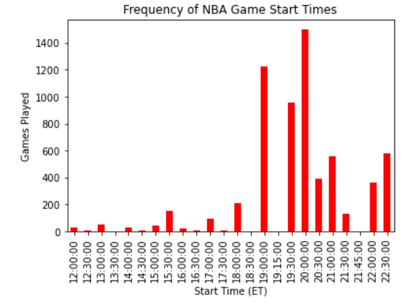
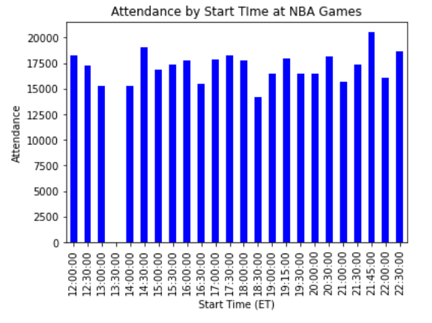
Game Start Times
Is there an attendance advantage to starting games at certain times?
Most NBA games start between the 7-9 PM ET range, but average attendance levels are relatively constant throughout the day
Takeaway & Next Steps: Analyze impact of weekend versus weekday start times on attendance, but the NBA could consider starting games earlier in the afternoon or even later at night

Slide 10
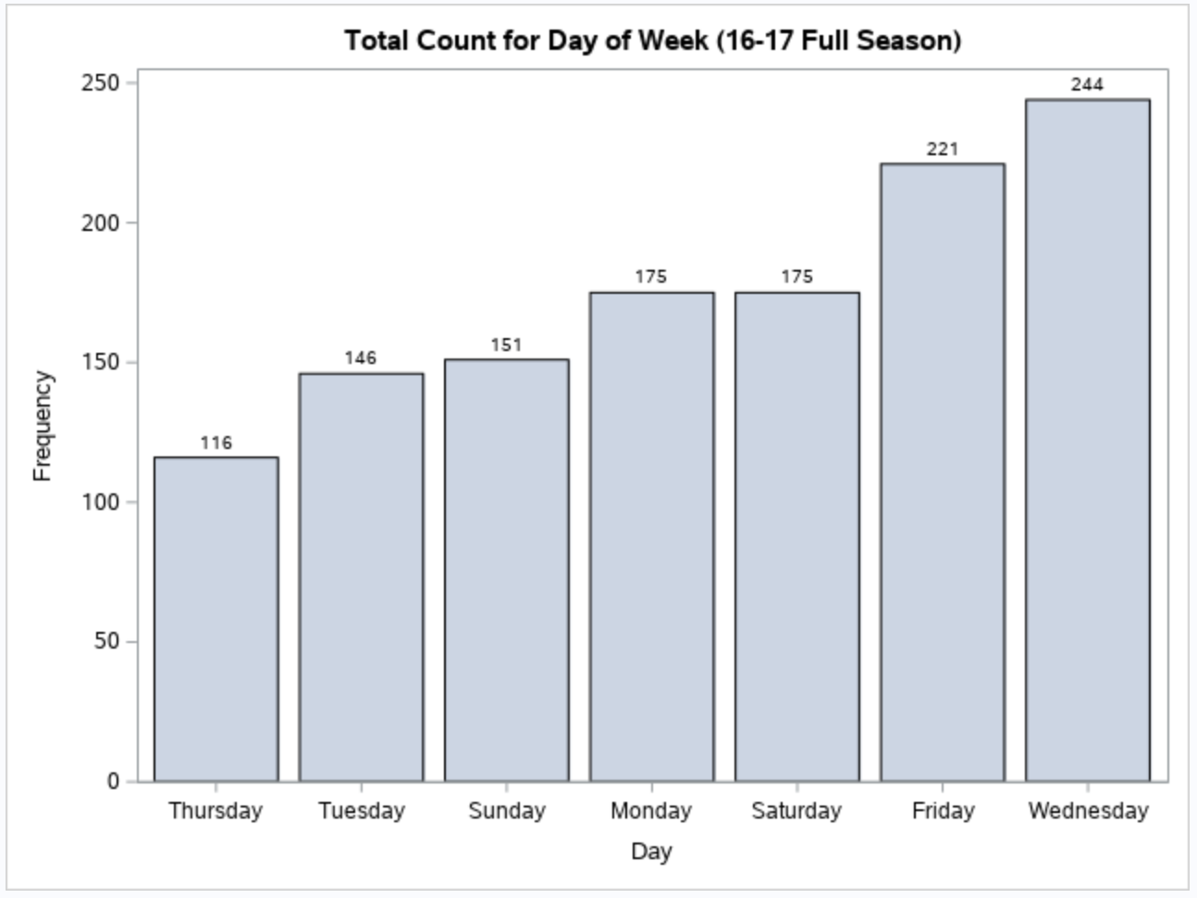
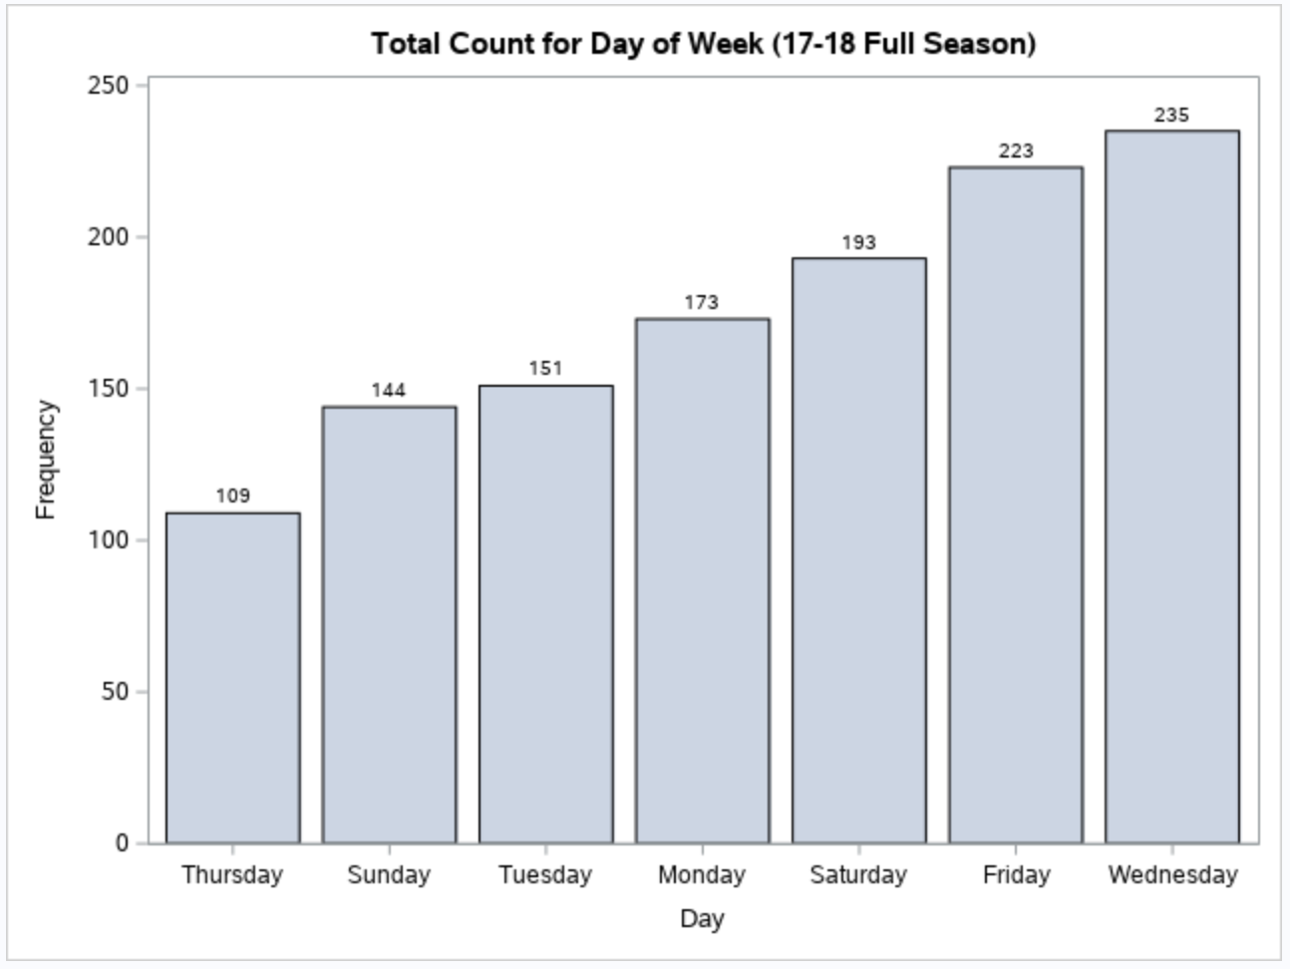
Count of Games by Day
Weekdays: 681
Weekend (Fri, Sat, Sun): 547
Weekdays: 668
Weekend (Fri, Sat, Sun): 560
Notes:
*Tip: To “demote” text to a sub-level bullet, place the cursor after the last line of text. Hit enter, then tab. This will automatically format the bullets according to the next level. Hit tab again to continue to demote up to four levels.

Slide 11
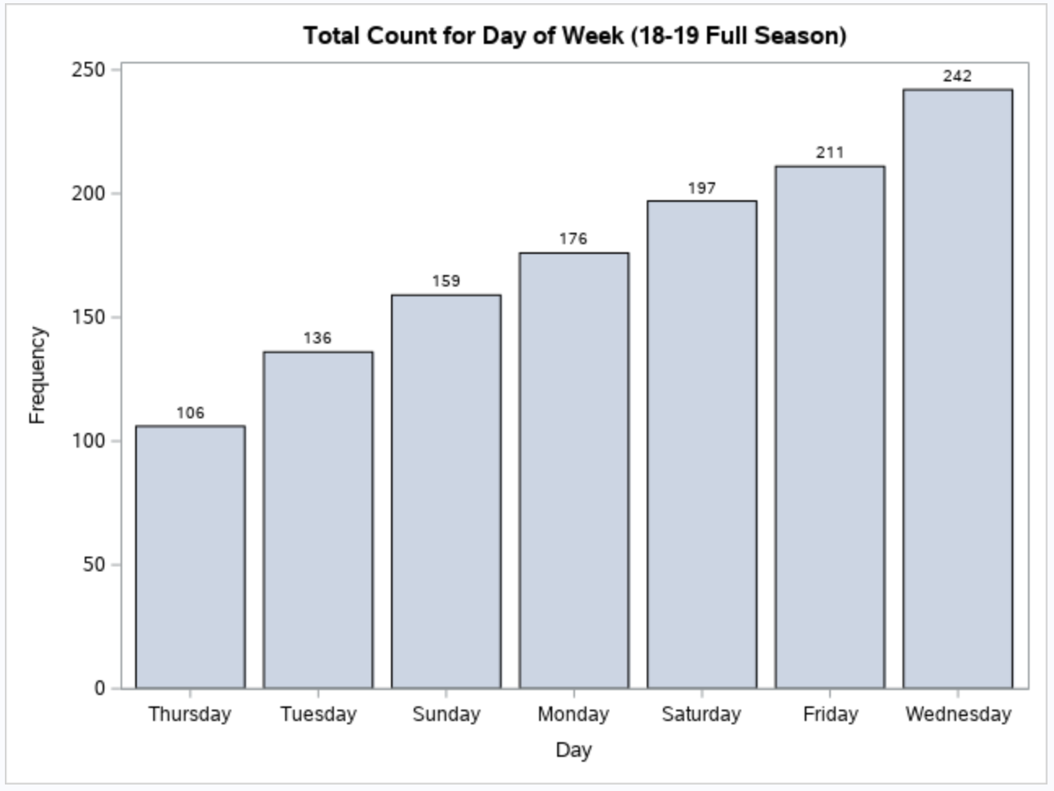
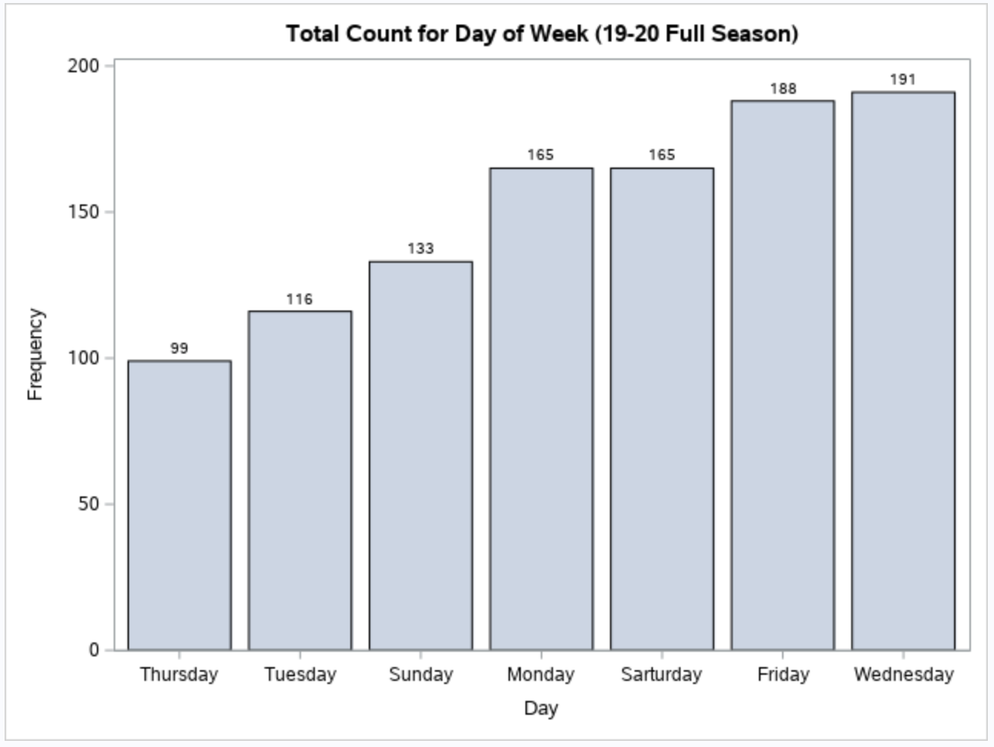
Count of Games by Day
Weekdays: 660
Weekend (Fri, Sat, Sun): 567
Weekdays: 571
Weekend (Fri, Sat, Sun): 486
Notes:
*Tip: To “demote” text to a sub-level bullet, place the cursor after the last line of text. Hit enter, then tab. This will automatically format the bullets according to the next level. Hit tab again to continue to demote up to four levels.

Slide 12
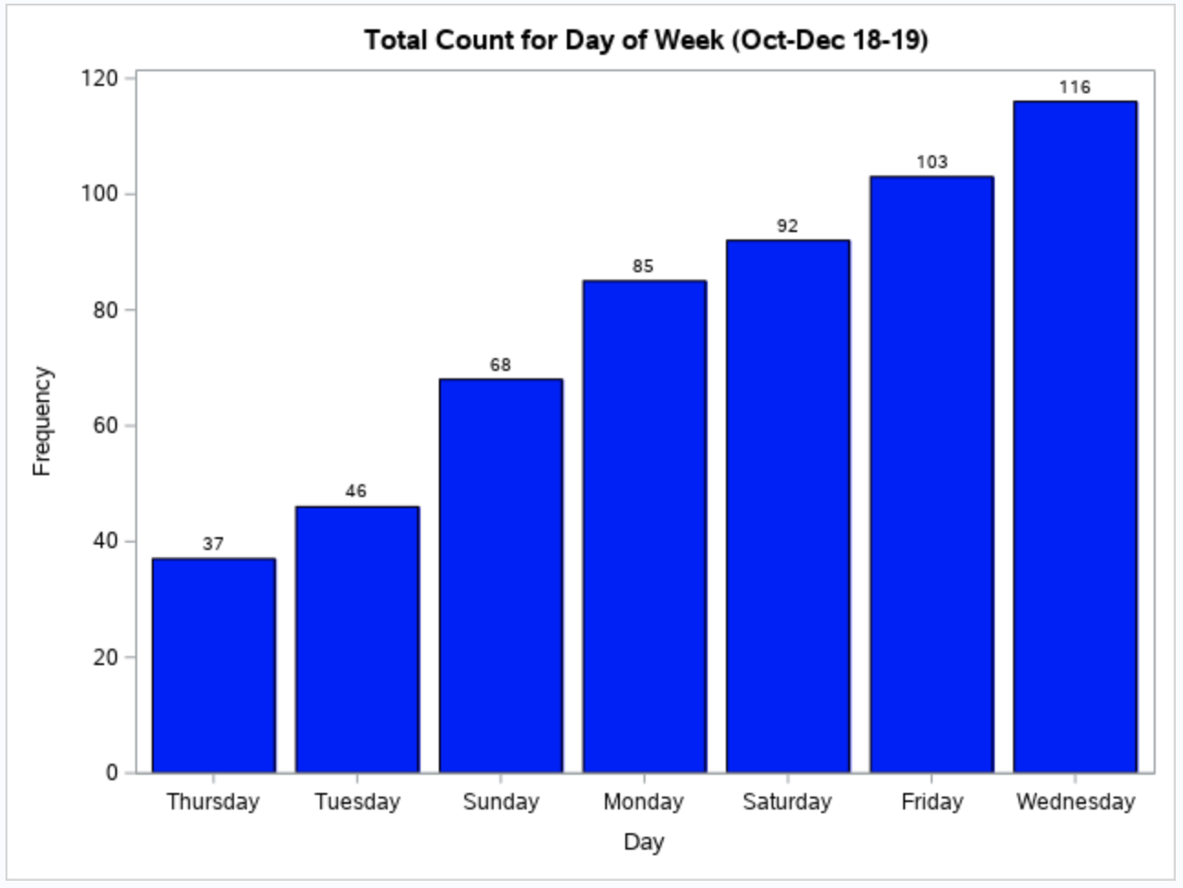
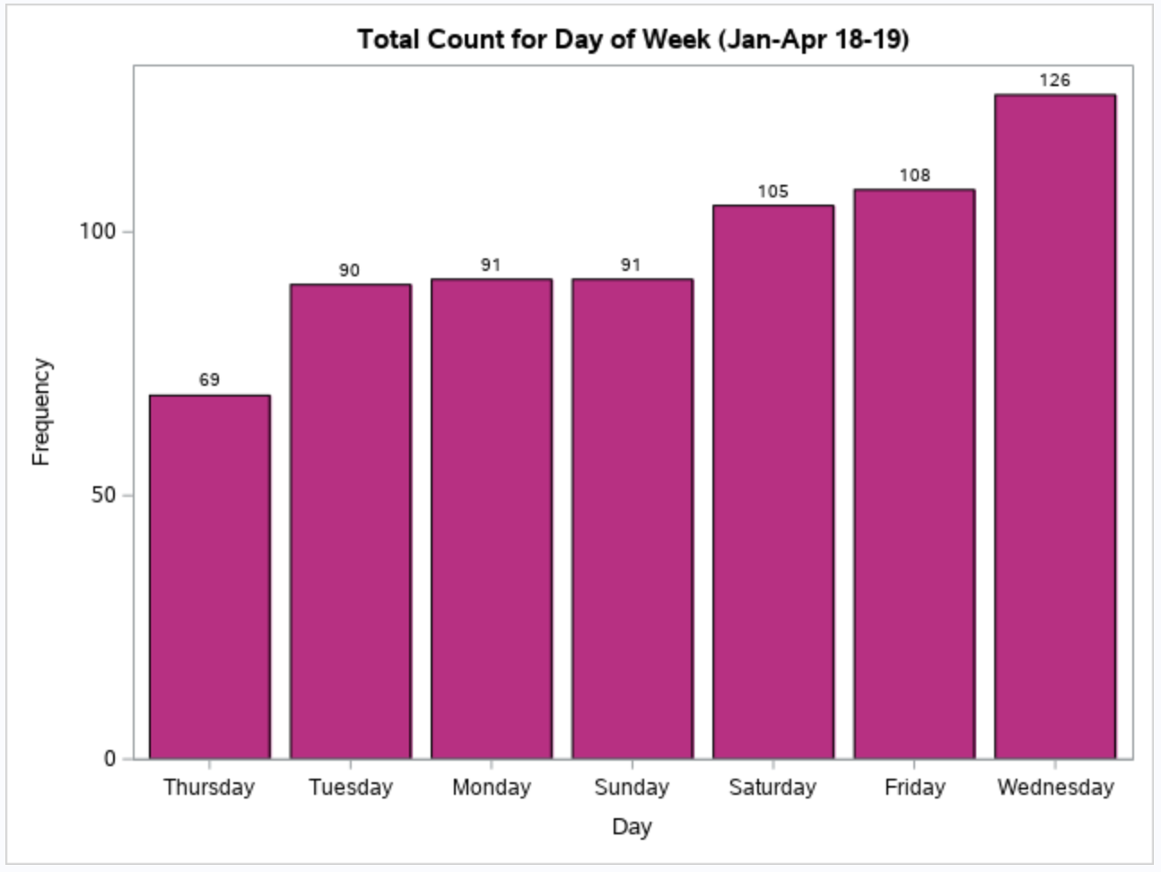
Count of Games by Day (Oct-Dec vs. Jan-Apr)
Weekdays: 284
Weekend (Fri, Sat, Sun): 263
Weekdays: 376
Weekend (Fri, Sat, Sun): 304
Notes:
*Tip: To “demote” text to a sub-level bullet, place the cursor after the last line of text. Hit enter, then tab. This will automatically format the bullets according to the next level. Hit tab again to continue to demote up to four levels.

Slide 13
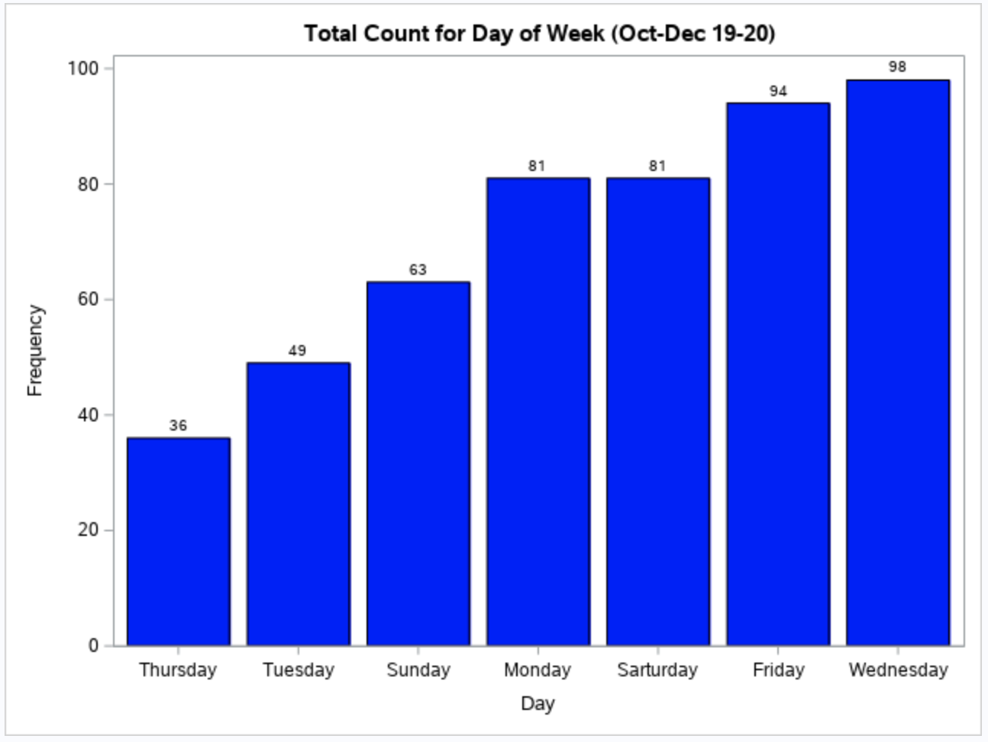
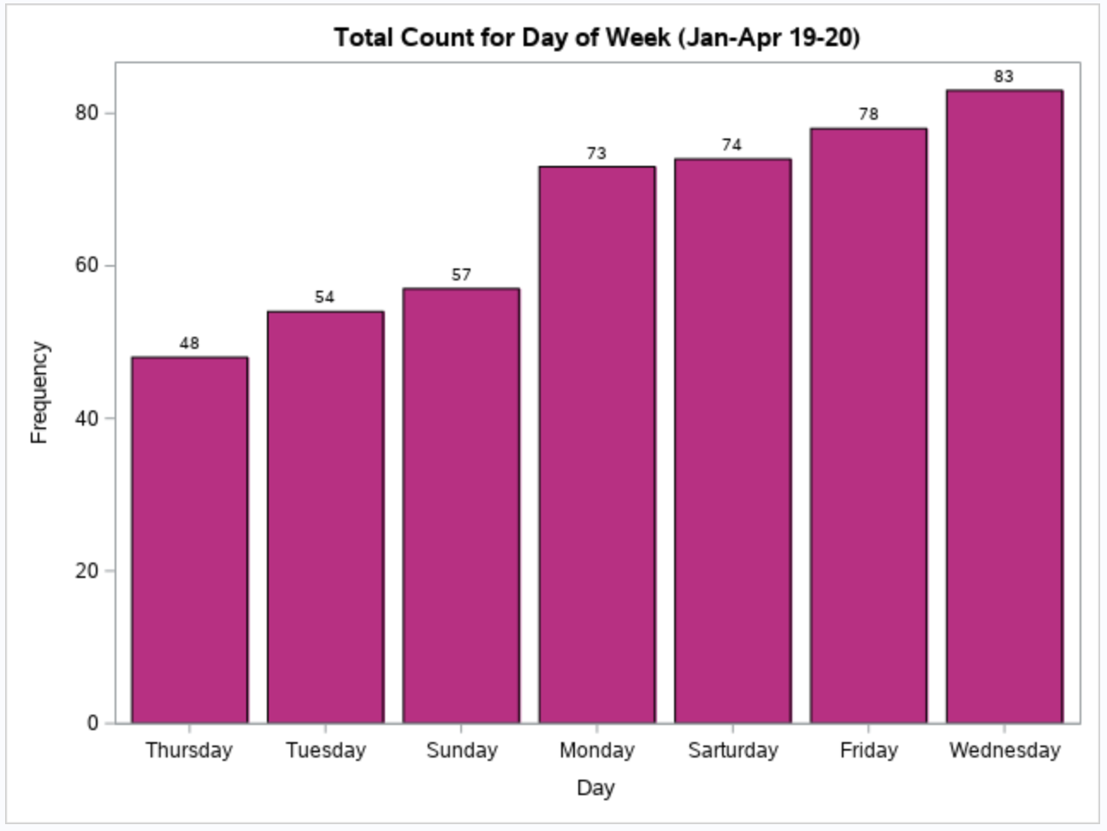
Count of Games by Day (Oct-Dec vs. Jan-Apr)
Weekdays: 264
Weekend (Fri, Sat, Sun): 238
Weekdays: 258
Weekend (Fri, Sat, Sun): 209
Notes:
*Tip: To “demote” text to a sub-level bullet, place the cursor after the last line of text. Hit enter, then tab. This will automatically format the bullets according to the next level. Hit tab again to continue to demote up to four levels.

Slide 14
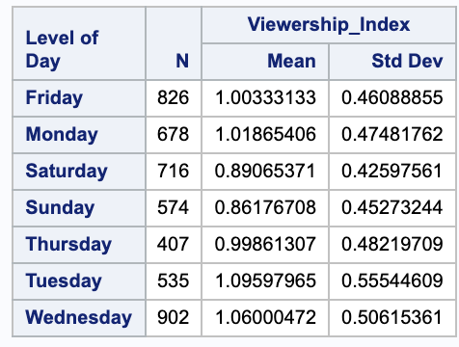
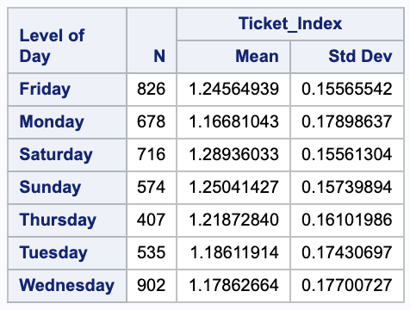
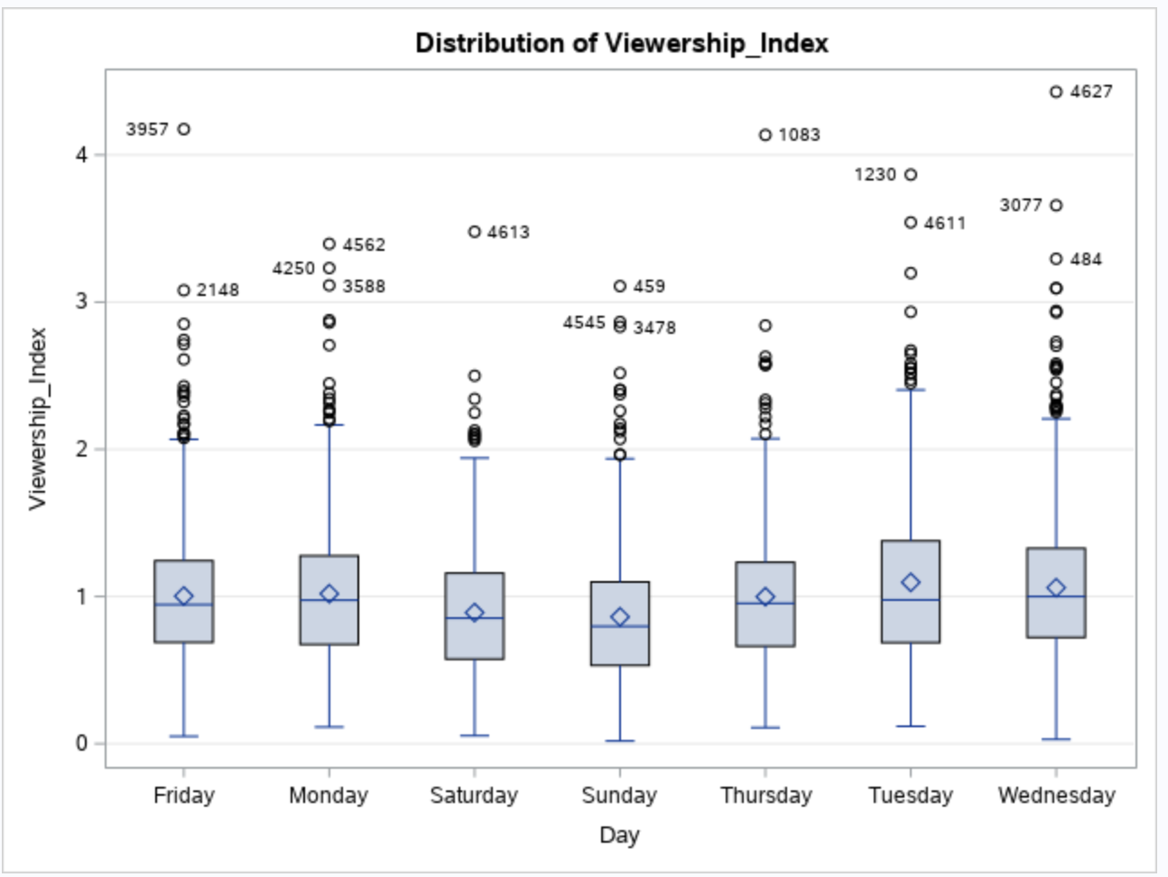
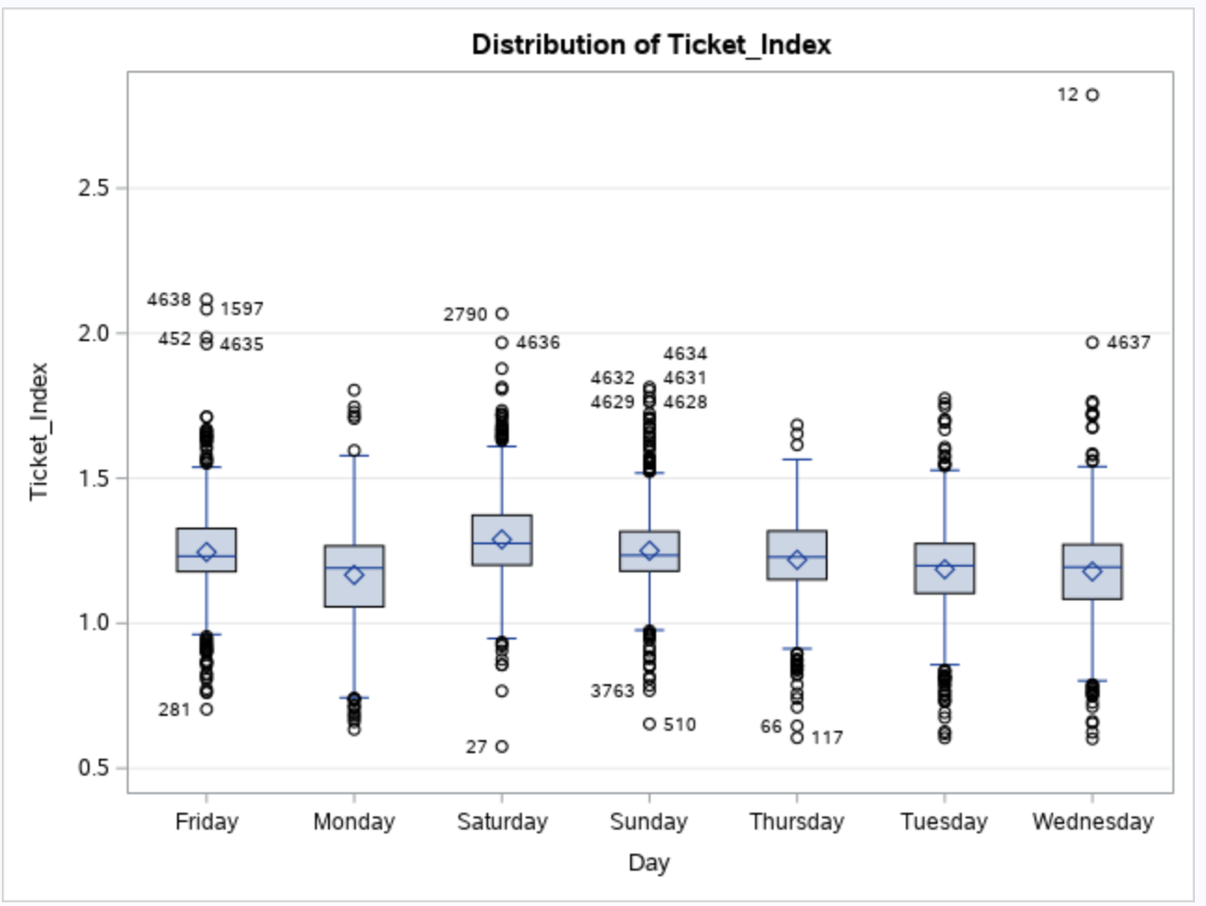
Ticket and Viewership
Notes:
All Season and Month Data

Slide 15
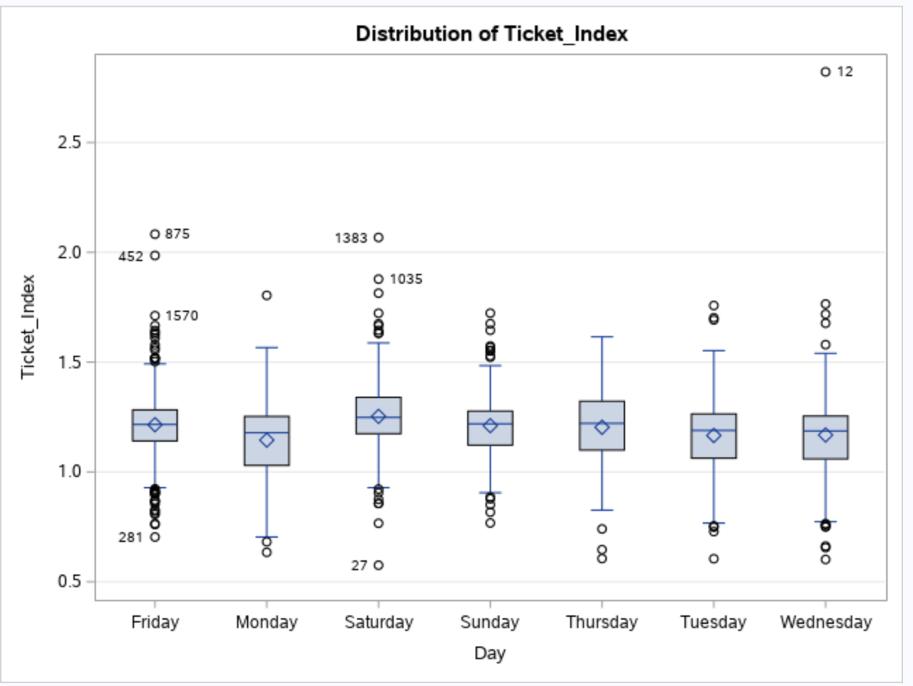
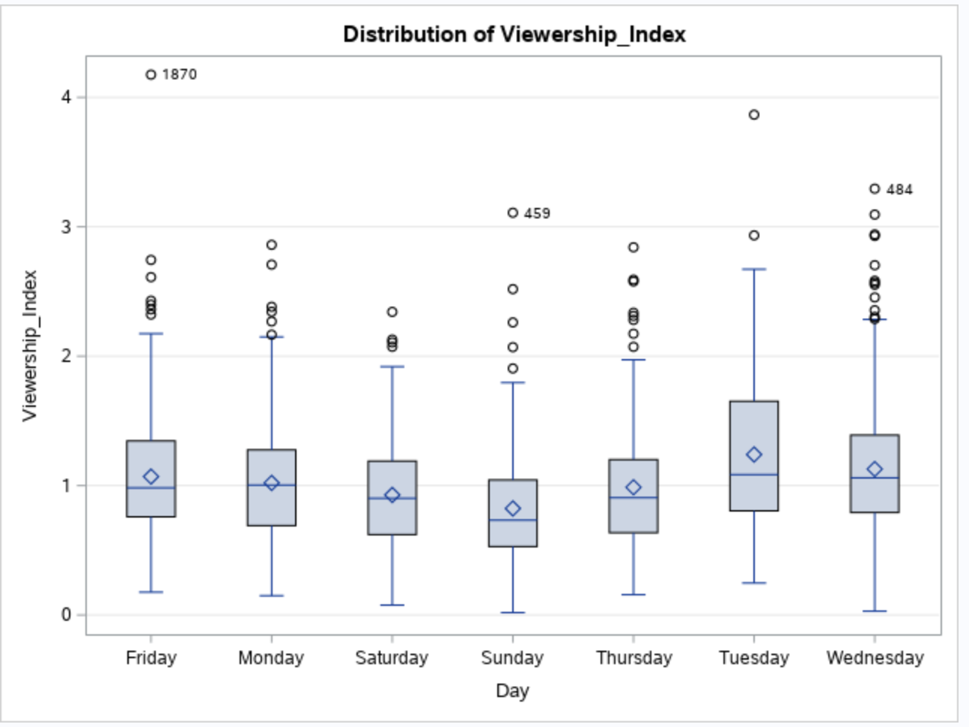
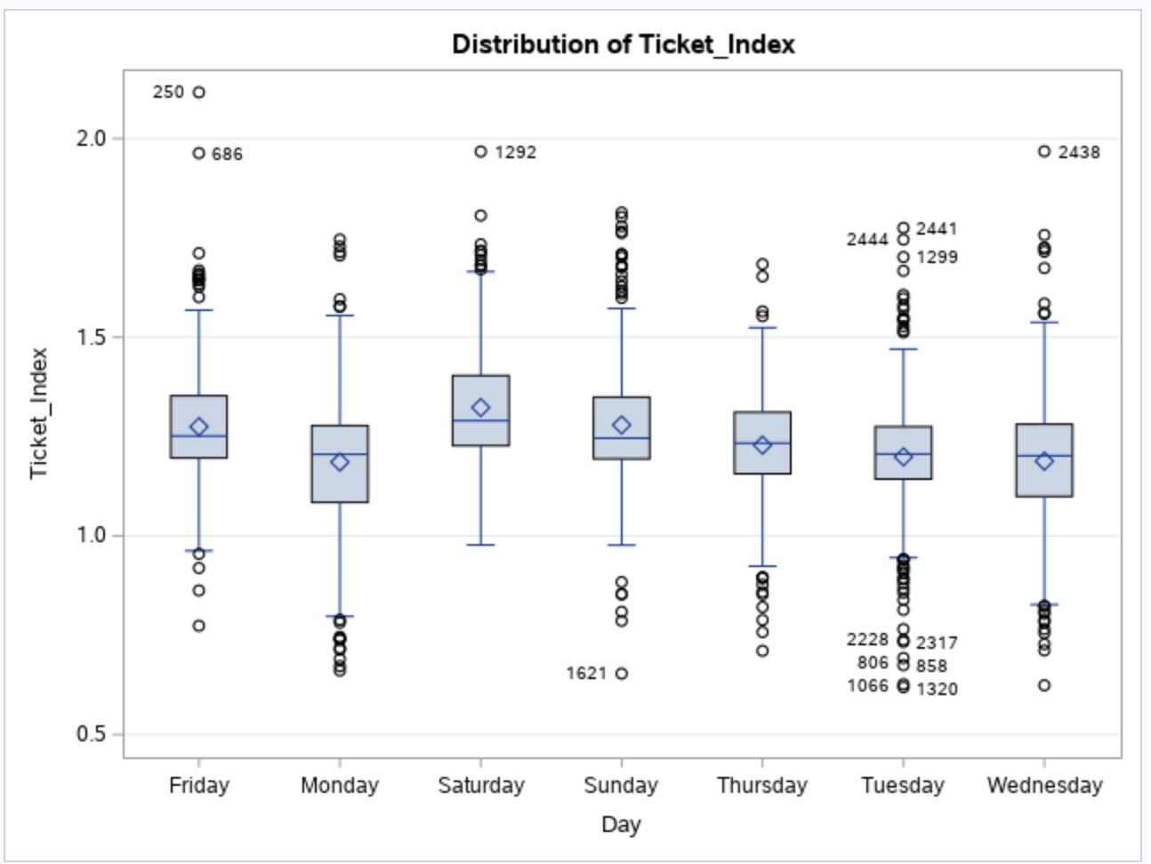
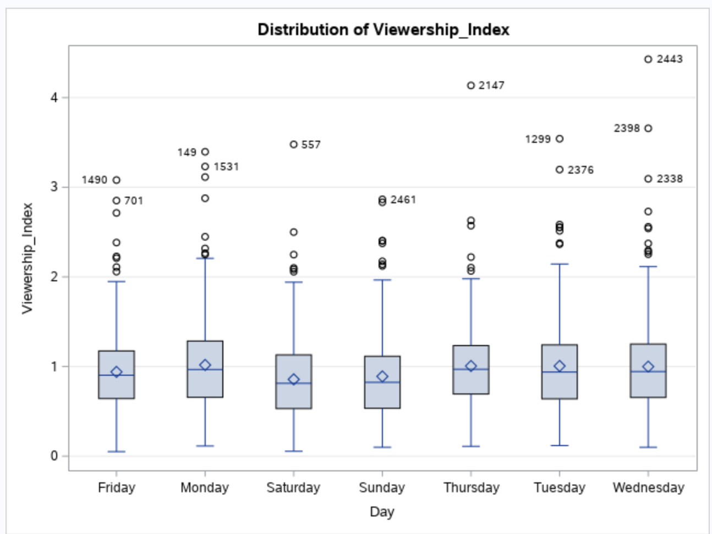
Ticket and Viewership
(Oct-Dec)
(Oct-Dec)
(Jan-Apr)
(Jan-Apr)
Notes:
*Tip: To “demote” text to a sub-level bullet, place the cursor after the last line of text. Hit enter, then tab. This will automatically format the bullets according to the next level. Hit tab again to continue to demote up to four levels.

Slide 16
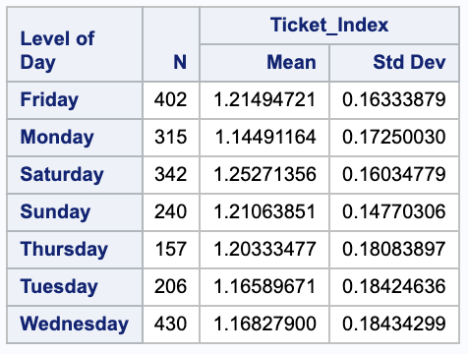
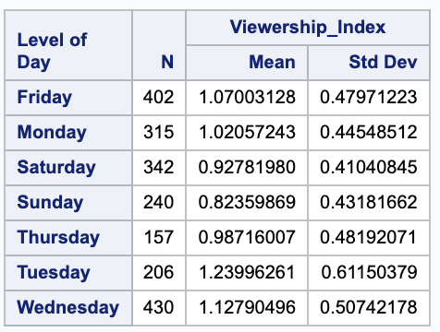
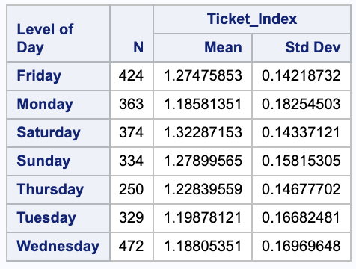
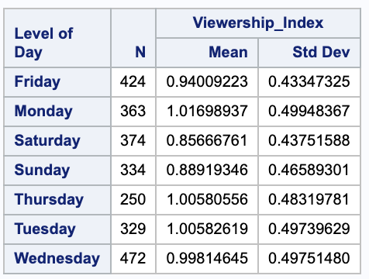
Ticket and Viewership
Ticket (Oct-Dec)
Viewership (Oct-Dec)
Mean of Ticketing and Viewership in different time periods
Ticket (Jan-Apr)
Viewership (Jan-Apr)
Notes:
*Tip: To “demote” text to a sub-level bullet, place the cursor after the last line of text. Hit enter, then tab. This will automatically format the bullets according to the next level. Hit tab again to continue to demote up to four levels.

Slide 17
Competitiveness & "A+ Games"

Slide 18
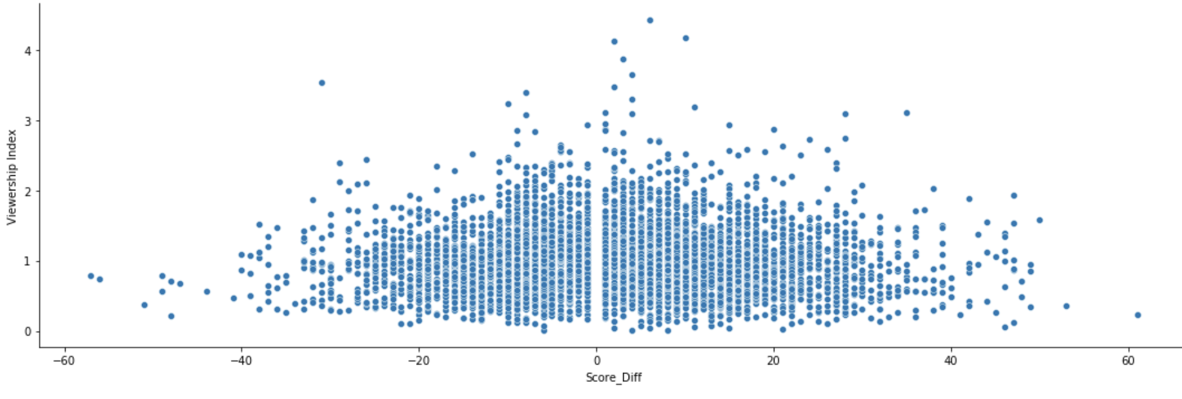
Score Difference
Does competitiveness of the game increase viewership ratings? Create and analyze the 'Score_Diff' column to assess competitiveness during the game itself.
As score gets closer or potentially goes into OT, does TV viewership increase?
Intuition: As Score_Diff approaches closer to 0, viewership will increase
Analysis: Not a strong linear correlation between the variables. Major score deficits still can earn high ratings

Slide 19
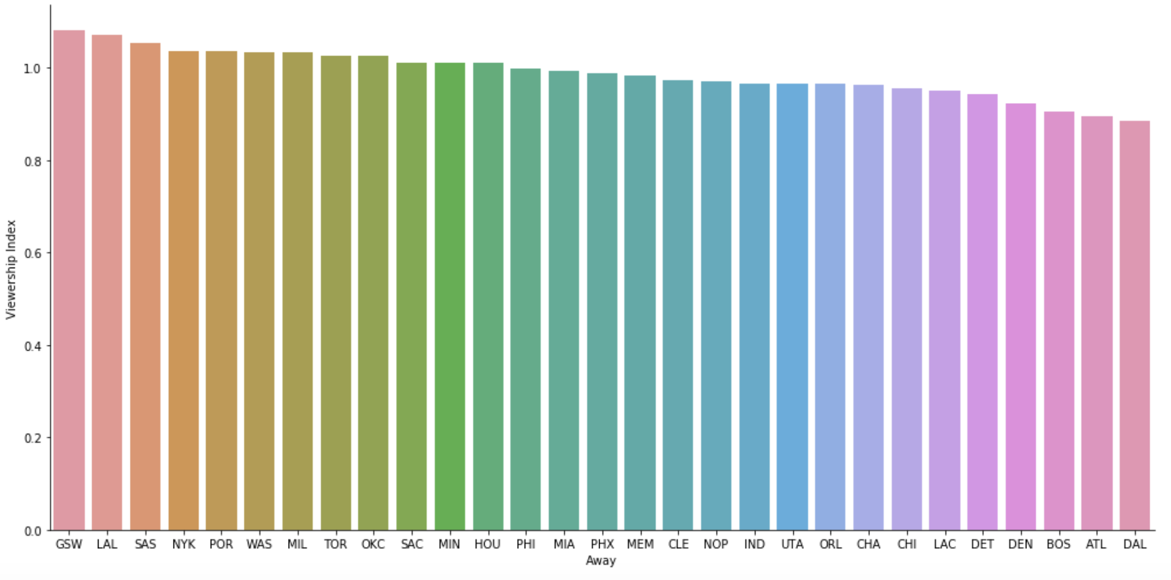
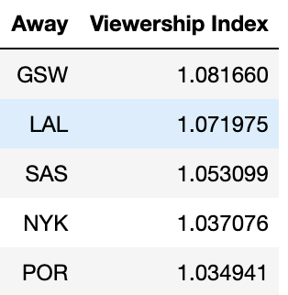
Overall Viewership by Team
Which team yields the highest viewership when they're the visiting team in town?
For all the seasons combined, the 5 teams in the table above earned the highest viewership when they're the visiting team. It's interesting to note how high the Knicks rank given their performance the past few years...
We'll further break down how this visual changes by season
Notes:
- important to note we did not have data on local vs. National channel ratings

Slide 20
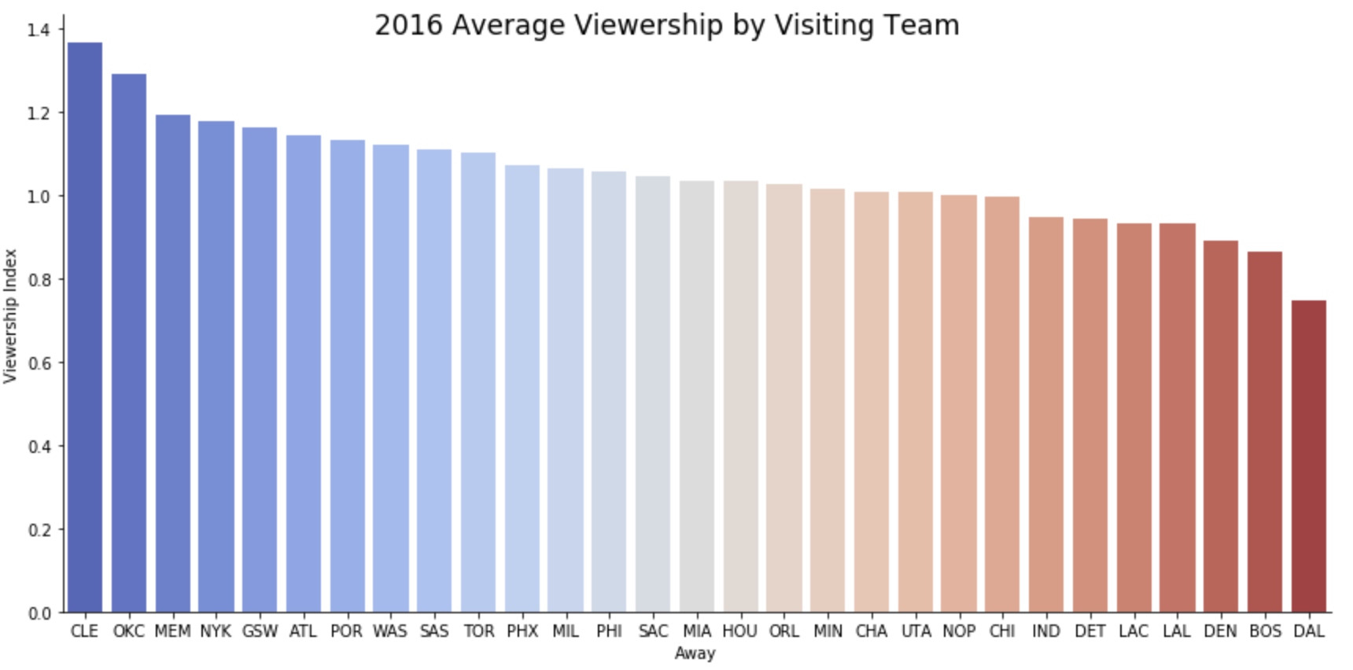
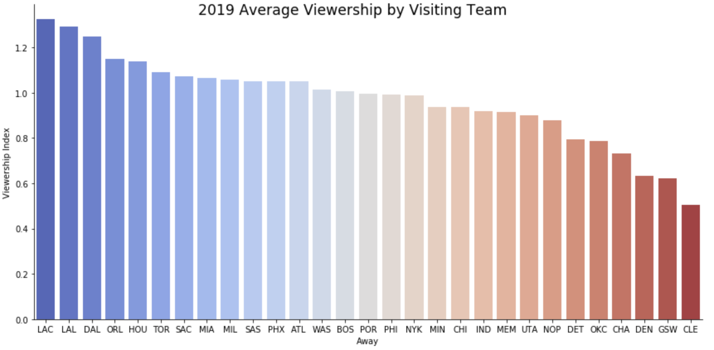
Overall Viewership by Team: Season-to-Season Comparison
Let's compare how Viewership by visiting team differs across seasons: 2016 vs 2019
Cavs ranked 1st by a significant amount in 2016, but earned dead last in 2019 season after Lebron left
Notable improvements: Dallas, Orlando, Clippers, Lakers
Conclusion: difference between seasons explains that constant player movement across teams makes it difficult to predict how viewership will be based on what team is visiting
Notes:
- league is unique in that trades happen all the time, players move around so often - 2019 instead of 2020 b/c the bubble

Slide 21
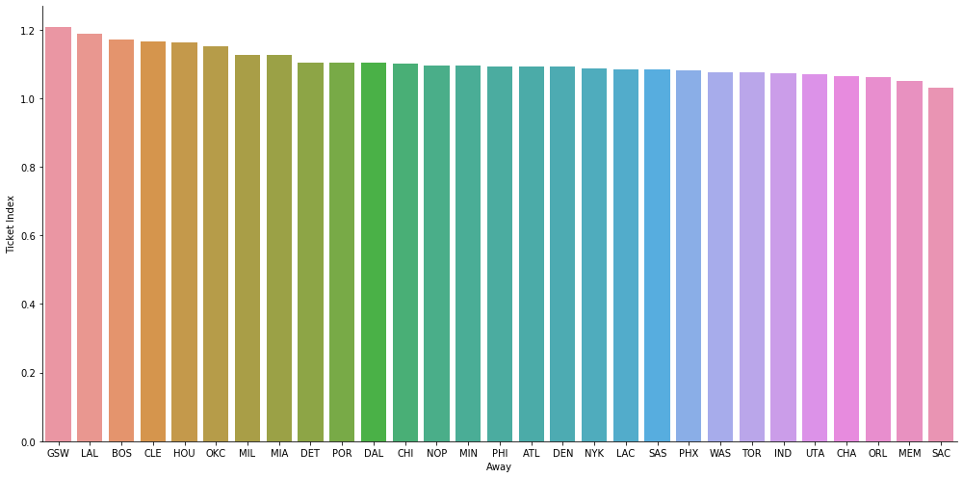
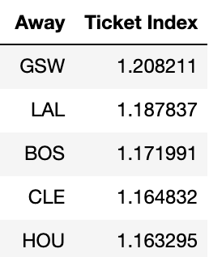
Overall Ticket Sales by Team
Which team yields the highest average ticket index when they're the visiting team?
For all seasons combined, these 5 teams yield highest ticket indices when they’re in town, no surprise
Interesting to note that Knicks tickets are relatively low while viewership is high. Walt and Mike are carrying MSG!

Slide 22
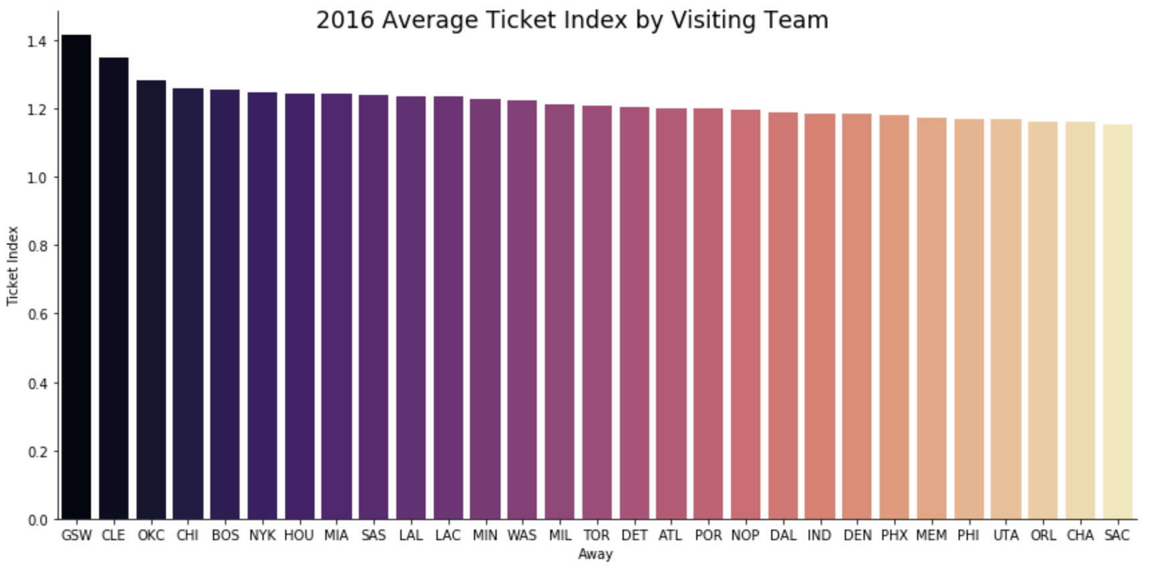
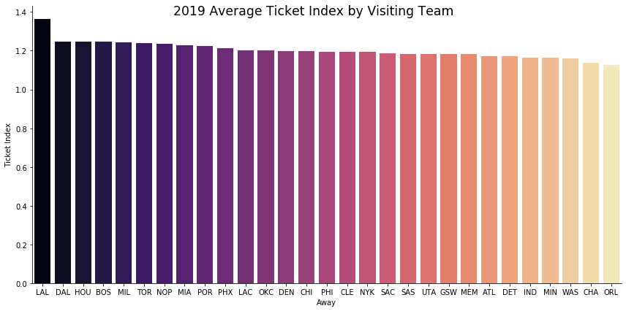
Overall Ticket Sales by Team: Season-to-Season Comparison
Compare 2016 vs 2019 but for ticket index
Increase in LAL ticket index magnifies Lebron's impact
CLE continues to significantly move down the team rankings for this metric once Lebron left
Combined with results from viewership analysis, this comparison exposes how player-driven ticket sales are when it comes to which player is going to be in town, rather than brand strength/team of the opponent

Slide 23
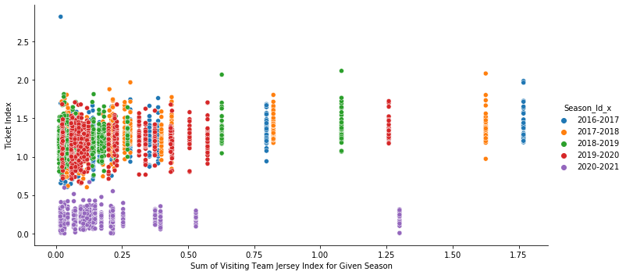
A+ Games: superstars in town
Calculated total Jersey index for each visiting team per game to represent popularity of the opponent in town using groupby and aggregating in Python
No strong, positive relationship between total jersey index of opponent and ticket sales index
Observe some variation between seasons; we can easily see the pandemic's impact on the 2020-2021 season's ticket sales

Slide 24
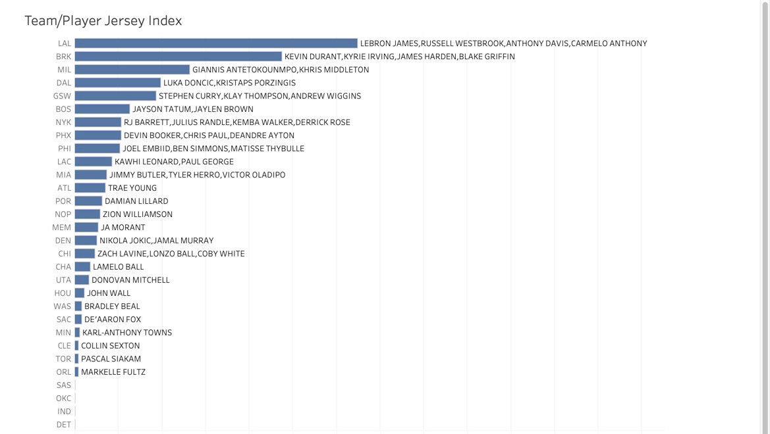
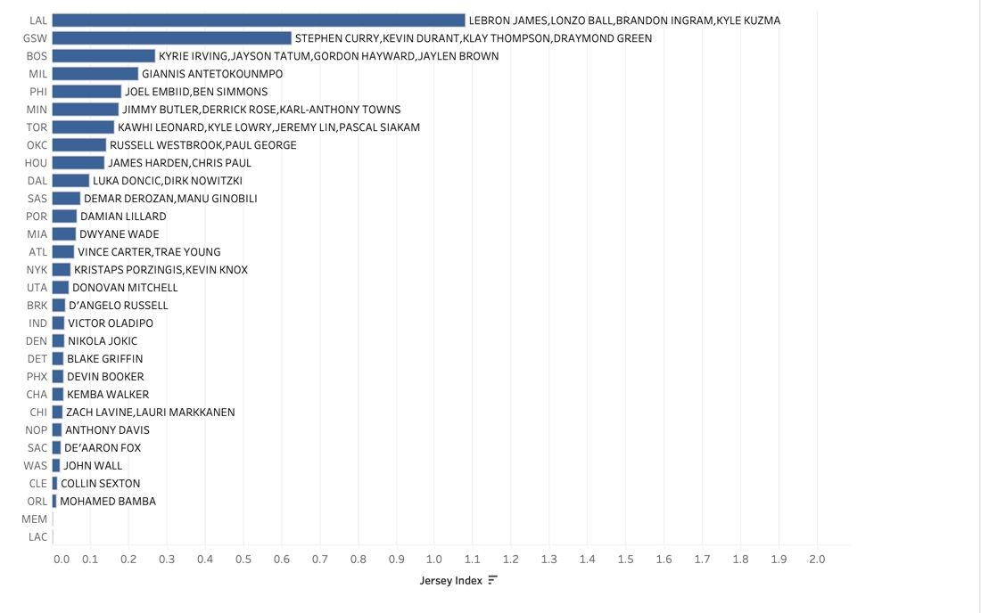
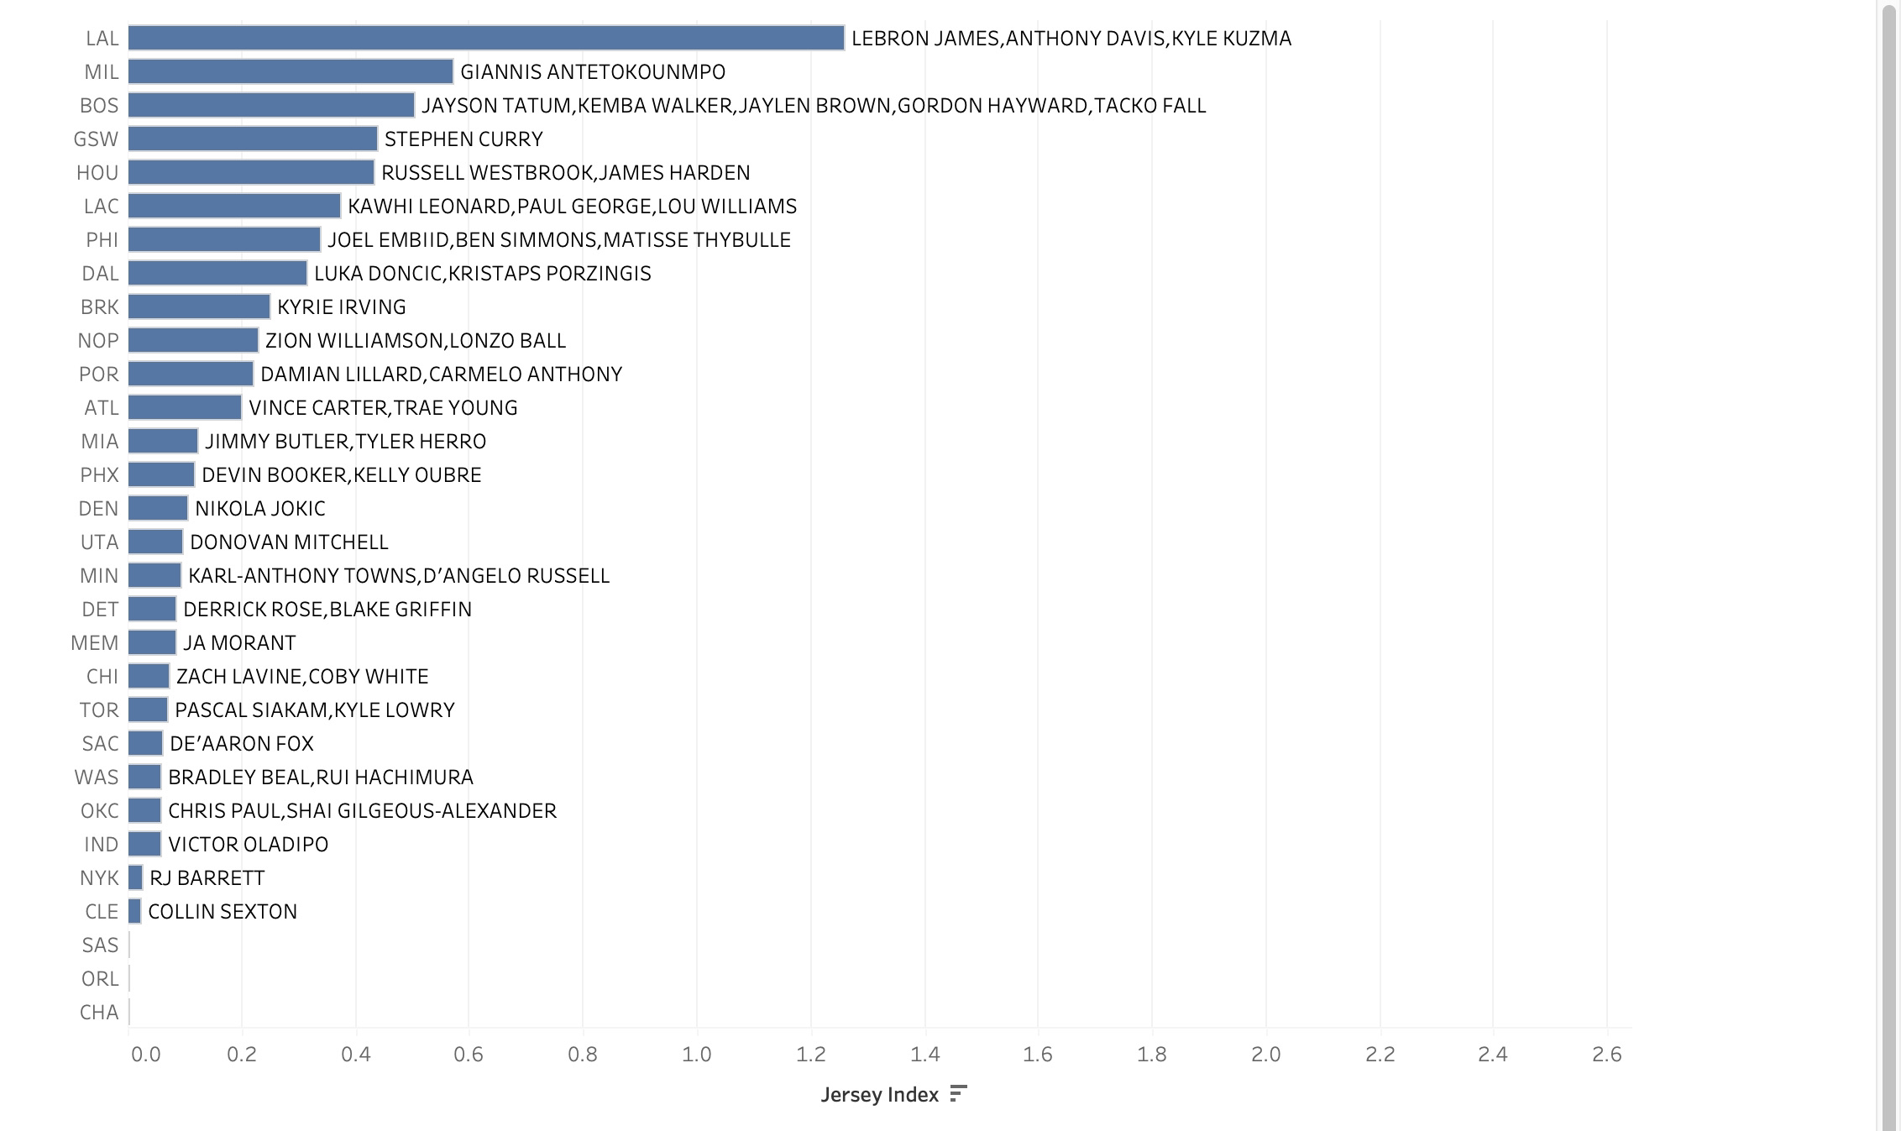
Team/Player Jersey Index 2018-2021
Total Team/Player Index is taking by aggregating all player jersey indexes across team name.
Jersey index is at relative value with Lebron at 1 and every other value based on that index. Example ( Giannis who placed 2nd in jersey index sold 2/5 less than Lebron in overall sales )

Slide 25
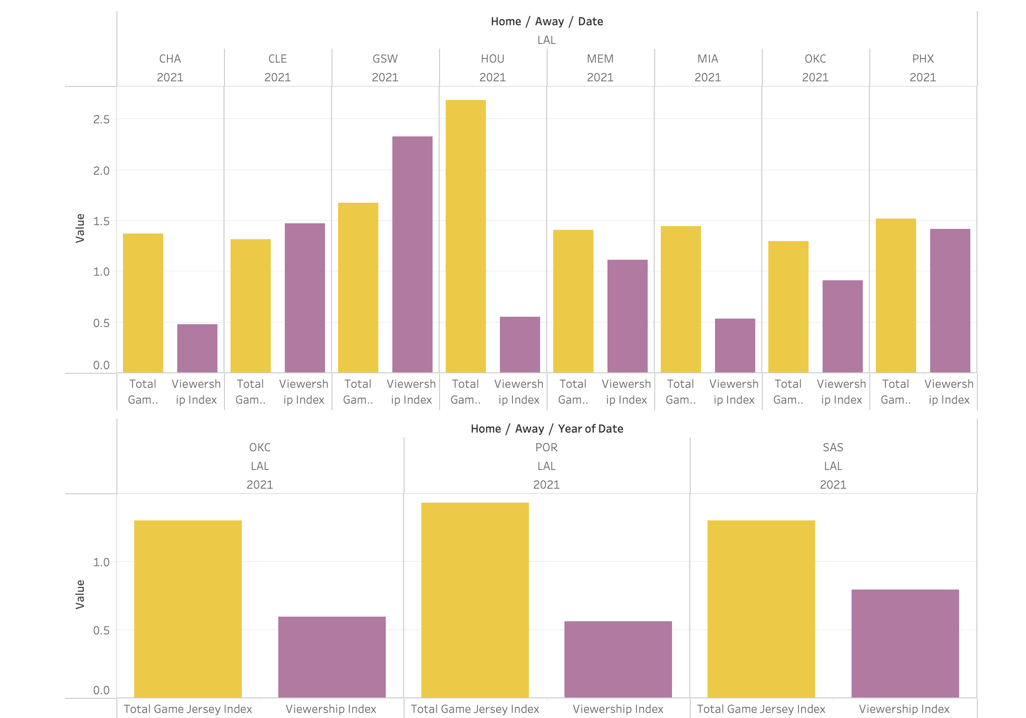
Max total Game Jersey index 2.68 (HOU/LAL)
Avg Viewership Index 1.09 (LAL Home Team)
Avg Total Home Game Index 1.60
Max Total Home Game Index 2.32
Max total viewership index .79 (LAL Away)
Avg viewership (local cable accessibility) 0.64
Max total game jersey index 1.42
Avg total game index 1.34
I used LA to display correlation because their brand coupled with superstar player(s) dominate jersey index and overall viewership
Although not completely parallel viewership and jersey index follow a synchronized pattern ( high jersey index = high viewership )

Slide 26
Road Back to Backs

Slide 27
Road Back to Backs intro.
Inspired by Athletic article interviewing Tom Carelli, senior VP of game schedule management and Evan Wasch, executive VP of basketball strategy and analytics
Article discussed the complex process of how the NBA picks its schedule and how certain back to backs are coded based on their difficulty
Ex: Por-Den back to back was too brutal on teams because of the flight, time difference, altitude, and distance from airport to stadium
Wanted to do a statistical analysis of other pairs of locations in road back to backs

Slide 28
Road Back to Backs Graph
Relationship between Standardized Points Scored and Standardized Points Allowed in the second game of a road back to back
Standardized to team’s average performance in road games that season
Each point corresponds to a road back to back that has been played atleast 10 times since the 2010 season
Defense really struggles on road back to backs as most teams are giving up more points than average
Scoring does not seem to be too affected
Consider that certain locations are affected by how good the home team is (Ex: LAL-GSW)
Identify troubling back to back pairs (UTA-DEN, PHX-LAC)
Look at other metrics in future

Slide 29
Final Takeaways and Recommendations
Player factor is more important than brand factor for certain teams
- Potential ticket buyers know when an individual superstar is in town and will buy accordingly
- Lebron: in a league of his own
Schedule should spread out more of these statistically significant variables across the schedule
- Lebron usually sells well no matter the circumstance
- Friday-Sunday games tend to have highest attendance
Initiate and brand something equivalent to "Thursday Night football" <- designated day of week to expect A+ team vs. A+ team game across the league beyond the Opening and Christmas Day games
Look closer into certain pairings of road back to backs to determine which pairings should be eliminated

Slide 30
Opportunities for Further Analysis
If a team visits twice, how does viewership and ticket sales differ between the two games?
2. Factor in "expected competitiveness" of a game by incorporating the opponent's prior season standing before the game is played
3. Local vs national television effects on Viewership <- separate the two for more conclusive observations
4. Look at injuries, turnovers, pace of play, lead changes, etc. to evaluate quality of basketball on road back to backs

Slide 31
Thank you!

